Slide 1
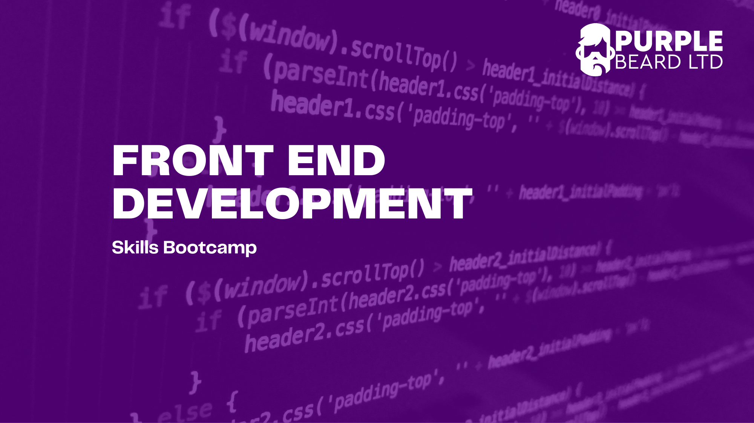
Week 2: CSS

Slide 2
Live Coding 201: Display
inline-block
block
inline
None, hidden
Week 1: CSS
Notes:
A block-level element always starts on a new line.
A block-level element always takes up the full width available (stretches out to the left and right as far as it can).
Two commonly used block elements are: <p> and <div>.
The <p> element defines a paragraph in an HTML document.
The <div> element defines a division or a section in an HTML document.
An inline element does not start on a new line.
An inline element only takes up as much width as necessary. E.g span, br, a input, textarea, button.
( inline can’t grow, no margin. Inline-block has margin top and it’s treated as an inline )
Display none: displays nothing.

Slide 3
Live Coding 202 & 203: Float
Left and Right
None
Clear (in brief)
Week 1: CSS
Notes:
The float property specifies whether an element should float to the left, right, or not at all.
None: The element does not float, (will be displayed just where it occurs in the text). This is default
Left: The element floats to the left of its container.
Right: The element floats the right of its container.

Slide 4
Live Coding 204 & 205: Position
Static
Relative
Fixed
Absolute
Week 1: CSS
Notes:
Static: Default value. Elements render in order, as they appear in the document flow
Absolute: The element is positioned relative to its first positioned (not static) ancestor element
Fixed: The element is positioned relative to the browser window
Relative: The element is positioned relative to its normal position, so "left:20px" adds 20 pixels to the element's LEFT position

Slide 5
Week 2: CSS
Exercises: Cards, and Position
When you get stuck, first search Google or W3 schools. A lot of being a developer is getting good at Googling problems – most developers don't know all the syntax off by heart.
If you are still stuck, ask the TA or Tutor – we are here to help!
We will go through the exercises either today or next week

Slide 6
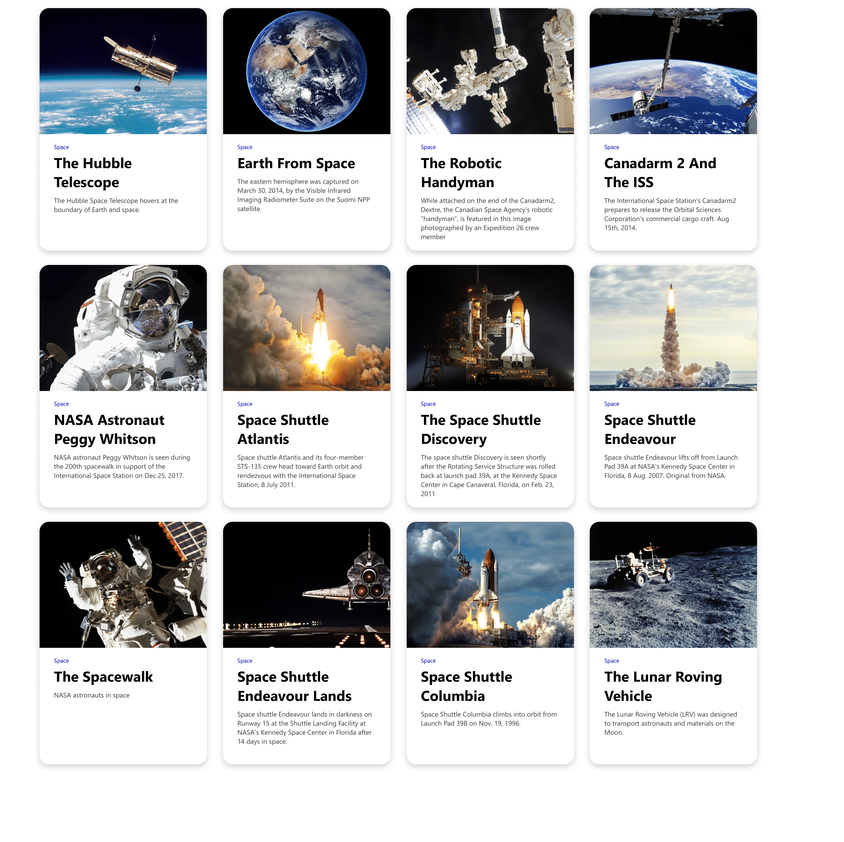
Exercise: Cards
Add the CSS you wrote for the Hubble card to the "Cards folder" CSS.
Change the .cards CSS "display" rule to make the cards display in rows
Change the vertical alignment of the cards so they all sit in a row
Experiment with all the different values for object fit for the images and see which you like best
Add a hover rule to the card which changes the box shadow when you hover over it

Slide 7
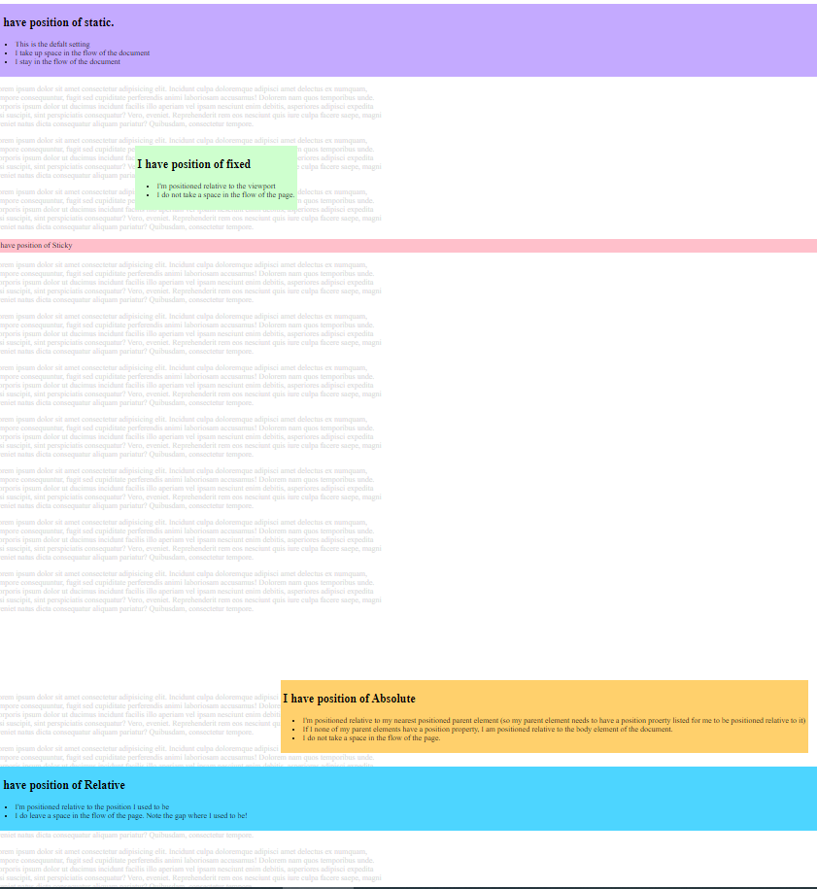
Exercise: Position
Download the Position boilerplate and follow the instructions in the CSS file
Have a go at changing the positions of the different elements

Slide 8
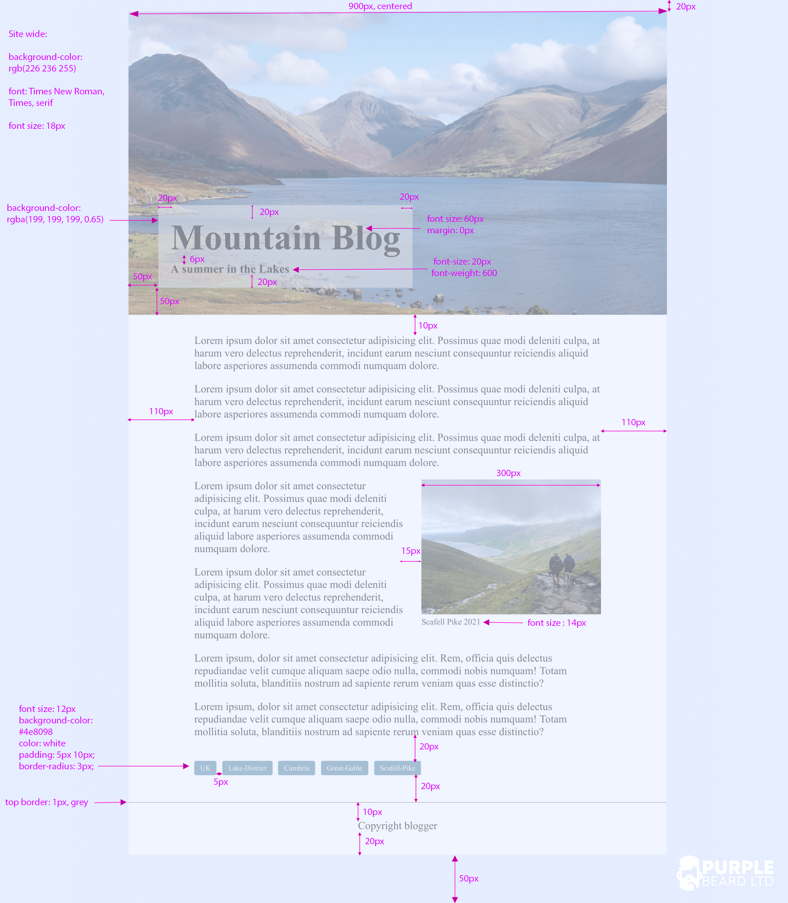
Week 2: CSS
Exercise: Mountain Blog

Slide 9

Week 2: CSS
Blog and Cards Code through

Slide 10


Slide 11

Questions?
Week 2: CSS

